Slide 1
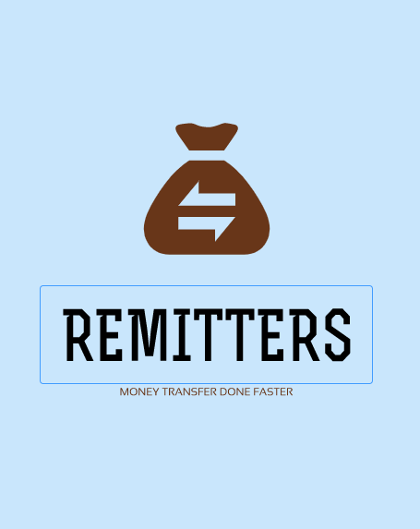


Slide 2

Problem
United Kingdom & Ireland
India
Image source: Shutterstock
Frustration in international student money transfers for students.

Slide 3


Market size and early adopters
400,000¹ students migrating for higher studies
12 billion euros² being transferred including tuition and living expenses
Rest of the world
India
United Kingdom & Ireland
Early adopters: International Indian Students in the UK & Ireland
Source available at : Uis.unesco.org. (2019). Global Flow of Tertiary-Level Students | UNESCO UIS. [online] Available at: http://uis.unesco.org/en/uis-student-flow [Accessed 7 Dec. 2019].

Slide 4
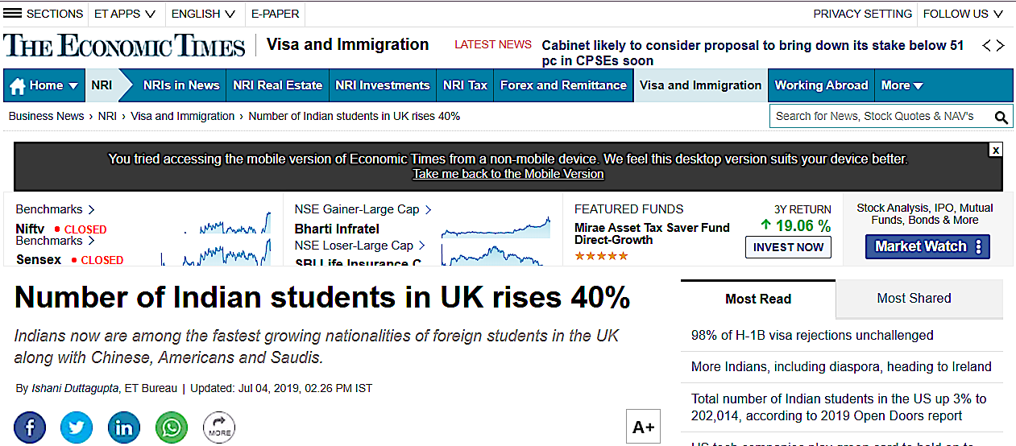
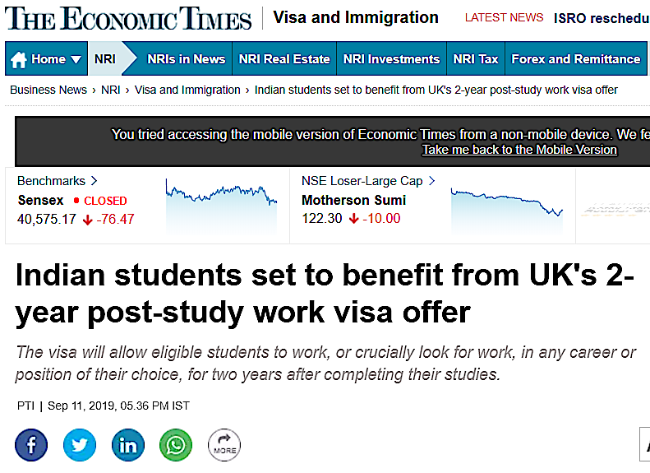
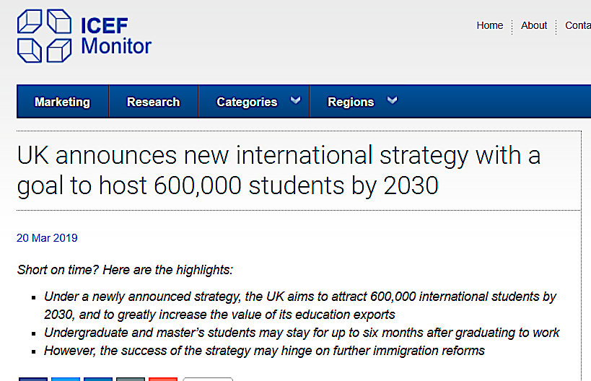
Early adopters: International Indian Students in the UK & Ireland
Source available at : Uis.unesco.org. (2019). Global Flow of Tertiary-Level Students | UNESCO UIS. [online] Available at: http://uis.unesco.org/en/uis-student-flow [Accessed 7 Dec. 2019].
Source available at : The Economic Times. (2019). Indian students set to benefit from UK's 2-year post-study work visa offer. [online] Available at: https://economictimes.indiatimes.com/nri/visa-and-immigration/indian-students-set-to-benefit-from-uks-2-year-post-study-work-visa-offer/articleshow/71081831.cms?from=mdr

Slide 5


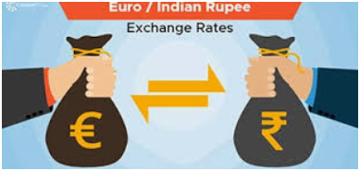


Challenges in international transactions
High Transaction fees
Long Transfer time
High Exchange rates
No Tracking & Transparency
No Dedicated Customer support

Slide 6


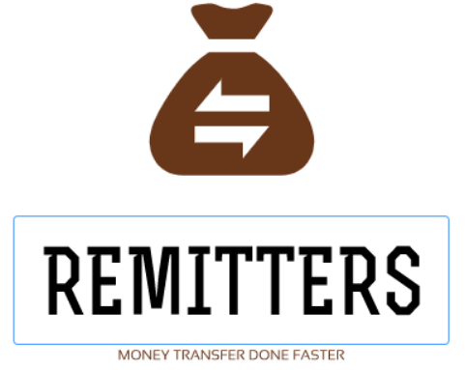
How we work
Student “A” from India
Institutional/recipient “B” in UK/IRL
Money from the sender gets deposited to the remitters Indian bank account
Money is transferred to the recipient’s bank account
INDIAN BANK
UK/IRISH BANK
Money gets updated in REMITTERS Indian bank account and a block is updated with the transaction details
Once the block is updated, REMITTERS UK/Irish bank account gets updated
Transfer of encrypted messages within remitters architecture using the blockchain technology

Slide 7



Unique Value Proposition
Low Transaction Charges
Real-Time Tracking
Super Fast Money Transfers
Predictive analysis of exchange rates
Trustworthy

Slide 8
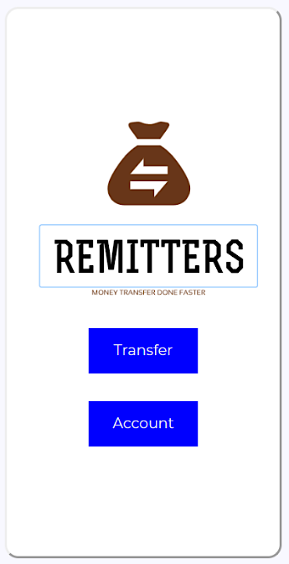
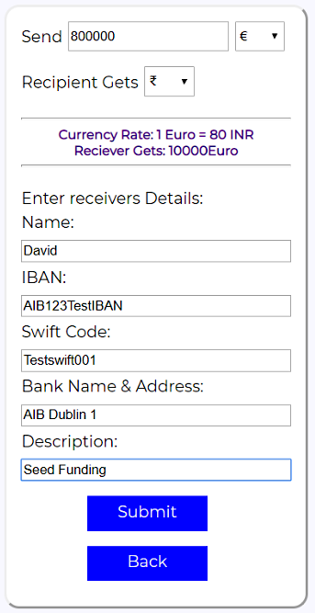
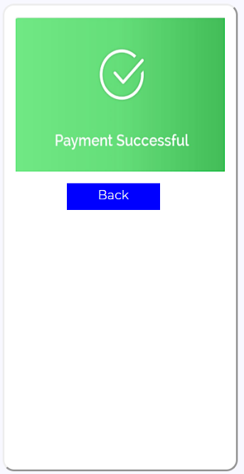
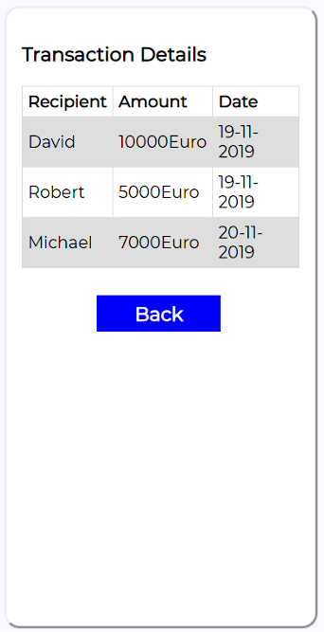
Prototype user interface

Slide 9
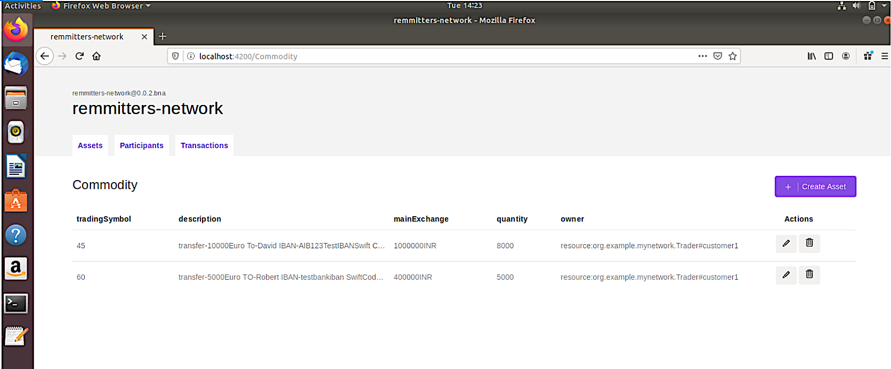
Underlying blockchain technology

Slide 10
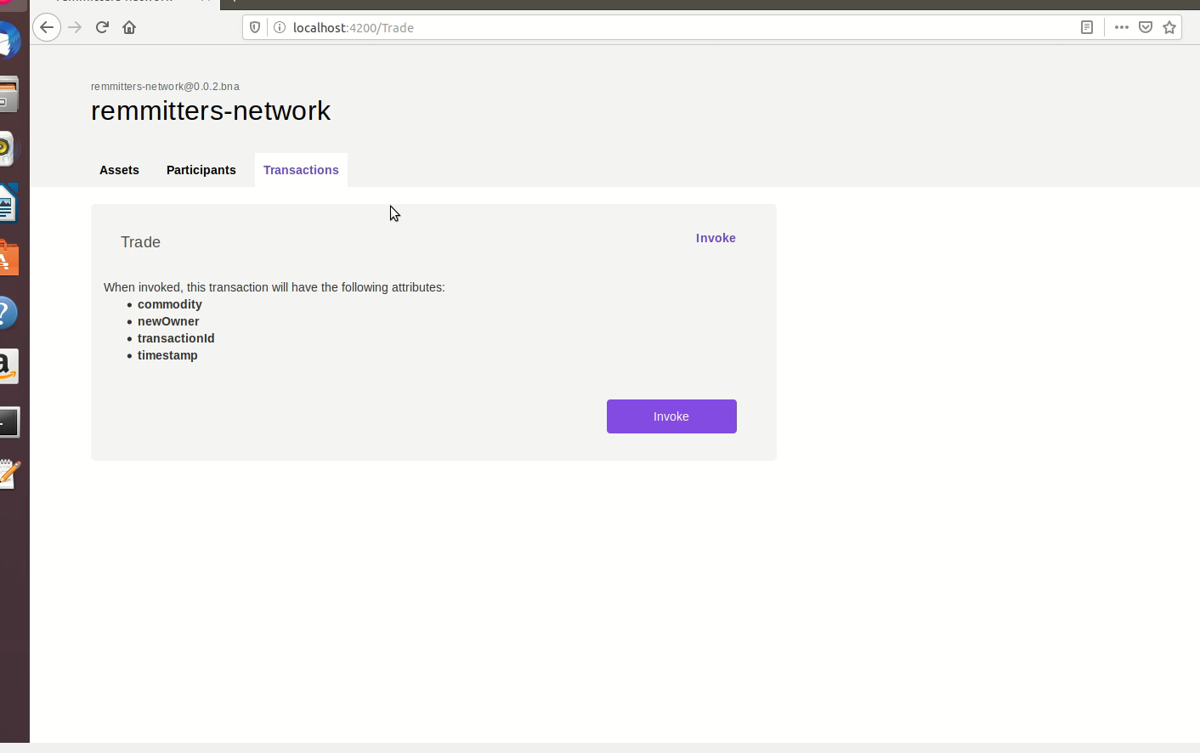
Prototype demo
Click to play

Slide 11
Business model
 | Freemium | Standard | Pro
Account opening fee | €0 | €0 | €0
Monthly Fee | €0 | €6.95 | €14.95
Transaction Charges | 0.8% | 0.6% | 0.4%
Limit per day | 3 transactions /week | 10 transactions /week | Unlimited
Currency exchange fee | Google rates | Google rates and fee prediction | Lock down of the fee rates

Slide 12
Revenue model
TRANSACTION
CHARGES
BANK INTEREST
RATES
PREMIUM MODELS
EXCHANGE
RATE DIFFERENCE

Slide 13
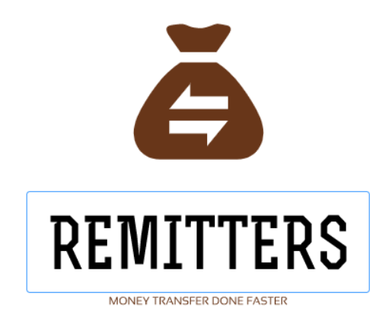




Marketing partners: study abroad agents in India
Highly reputable partners with direct access to prospective Indian students

Slide 14


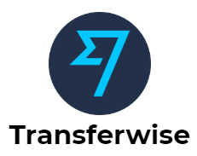


Competitors
What our early adopters want
Low Transfer Fees charges
Exclusively for students and international studies
Instant money transfer from india
lowest exchange rates
24/7 customer care availability

Slide 15
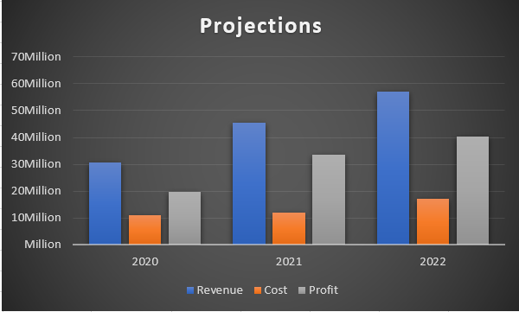
Projections

Slide 16




Team Contribution
Raghav Krishna Kumar (x18181848)
Market research
Feasibility analysis
Web-app implementation
Technical architecture
Blockchain implementation
Revenue strategy
Vinaysheel Kishor Wagh
(x18194303)
Statistical research
Blockchain development
Marketing strategy
Kamalesh Palani
(x18180311)
Finance overview
Competitors case study
Compliance and regulation
Shrey Sanjay Shah
(x18192271)

